Slide 1

DA 204o: Data Science in Practice Course Project Proposal TaxiFare Forecast – Enhancing Fare Accuracy with Machine Learning
Srividya L, IISc, srividhyal@iisc.ac.in
Kavipriya Ramasamy, IISc, kavipriyar@iisc.ac.in
Aravind S S , IISc, aravindss@iisc.ac.in
Rajib Roy, IISc, rajibroy@iisc.ac.in

Slide 2
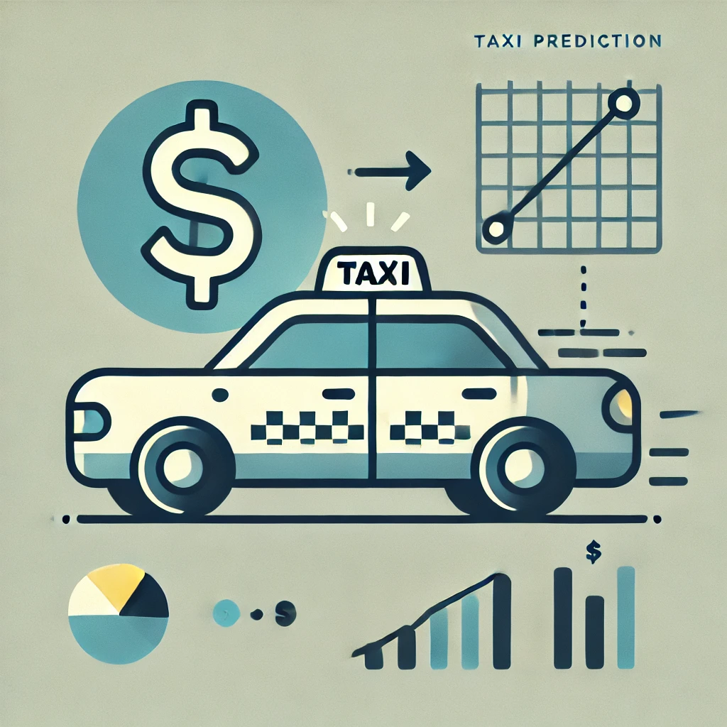
Problem Definition
1. Background of the Problem
Ride-hailing services offer dynamic pricing based on several factors like distance, time of day, demand, and traffic.. Customers often find unpredictable fares frustrating, and from a business standpoint, accurate fare prediction helps optimize pricing strategies.
2. Why is it Important?
Customer Satisfaction: By providing accurate fare estimates, ride-hailing services can improve customer trust, leading to higher user retention.
Operational Efficiency: Accurate predictions can help ride-hailing services optimize its pricing models to reflect market demand more precisely and efficiently allocate resources.
Fairness & Transparency: Having transparent and predictable fares creates trust between users and the platform
3. Objectives of the Project
Predict Taxi Fare: Build a machine learning model to predict taxi fares based on features like distance, location, and time.
Feature Importance: Identify the most influential factors that contribute to fare pricing.
Real-Time Prediction: Develop a model that can predict fares in real-time to offer estimates instantly to customers.
Optimization: Improve the accuracy and speed of fare predictions to ensure seamless integration with pricing system of ride-hailing services.
4. How Can Data Science Solve the Problem?
Regression Models: Since fare prediction is a continuous variable, data science can leverage machine learning regression models (e.g., linear regression, decision tress, random forests, gradient boosting) to accurately predict fares based on historical ride data.
Feature Engineering: Data science techniques can be used to extract relevant features from the dataset, such as time of day, location coordinates, weather conditions, and traffic data to improve the prediction model's performance.
Model Optimization: Data science allows for the tuning and evaluation of different models, helping to choose the one that balances accuracy with computational efficiency.

Slide 3
Data Science Canvas |  |  | Project: | TaxiFare Forecast – Enhancing Fare Accuracy with Machine Learning
 |  |  | Team: | Srividhya, Kavipriya, Aravind, Rajib
Problem Statement |  |  |  | Execution & Evaluation |  | Data Collection & Preparation
Business Case & Value Added Business case: Predicting taxi fares based on trip distance, time, and other factors can optimize pricing, customer satisfaction, and operational efficiency. Value added: Helps taxi companies offer dynamic pricing, improves customer transparency, and aids in forecasting operational demand for drivers and vehicles. | Model Selection Analysis methods: Consider regression models like Linear Regression, Decision Trees, XGBoost, and Random Forest for predicting fares. Ensemble methods can be useful in capturing non-linear relationships between the features and the target. : | Model Requirements The model should accurately predict fares with minimal error (e.g., use Mean Absolute Error (MAE) as a primary metric). Must handle geospatial and time-related data and consider fare variability based on factors like trip distance, time of day, and location. | Skills Data analysis and cleaning (using pandas, numpy). Model development and tuning (using scikit-learn, XGBoost). Data visualization (seaborn, matplotlib). | Model Evaluation Key indicators: Model performance should be validated using MAE, MSE, and R-squared scores. Monitoring of outliers and the model's generalization to unseen data through cross-validation is necessary. | Data Storytelling Communicate results using charts, graphs, and model interpretation techniques. Focus on explaining how factors like time of day, distance, and location affect fare predictions. Visualize feature importance. | Data Selection & Cleansing Use relevant data such as pickup/dropoff coordinates, trip distance, time of day, and passenger count. Clean missing or inconsistent values in features like fare amount or trip data. | Data Collection Collect historical taxi trip data, possibly from open datasets like Uber Fare Prediction. The data must include spatial (pickup/dropoff coordinates), temporal (timestamps), and fare-related variables.
Data Landscape Historical taxi trip data including fare amount, pickup/dropoff locations, distance, passenger count, and time. Additional data, such as weather conditions or special events, may be required to capture external influences on fare variability. |  | Software & Libraries pandas numpy matplotlib.pyplot seaborn scikit-learn xgboost joblib Json streamlit |  |  |  | Data Integration Not applicable since we are using only data source | Explorative Data Analysis Identify outliers, such as extreme fares, abnormal trip distances, or unreasonable passenger counts. Descriptive statistics (e.g., mean fare by distance) and visualization (e.g., histograms, scatter plots) to assess data quality and distribution.
Adopted from: https://github.com/tomalytics/datasciencecanvas

Slide 4

Data Collection and Preparation
Data source(s) (where it's from, how it was collected)
https://github.com/aravindsreekumar28/TaxiFare-Forecast/blob/main/Datasets/Raw.csv
Went through taxi fare prediction datasets in platforms like Kaggle, hugging face and finalized this one due to its larger sample size.
Description of the data (features, size, format)
Size: The dataset includes around 5,00,000 records.
Format: The dataset is in CSV format, making it easy to read and manipulate.
Features: 20+ features in the ingested dataset. Important features to consider:
pickup_datetime: The timestamp when the ride started.
pickup_longitude: Longitude of the pickup location.
pickup_latitude: Latitude of the pickup location.
dropoff_longitude: Longitude of the dropoff location.
dropoff_latitude: Latitude of the dropoff location.
passenger_count: Number of passengers for the ride.
trip_distance: Distance between pickup and dropoff points (derived feature).
Target variable : fare_amount
Any preprocessing steps required
Data cleaning : We will clean the data by handling missing values and removing irrelevant columns
Feature Engineering: We implemented oneHot encoding for categorical columns

Slide 5
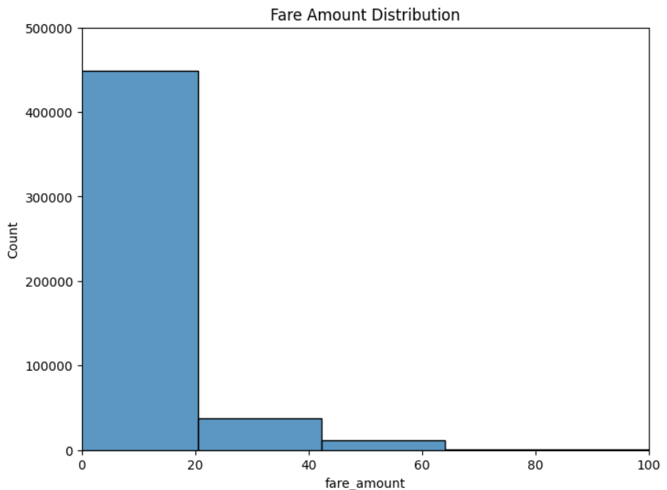

EDA

Slide 6
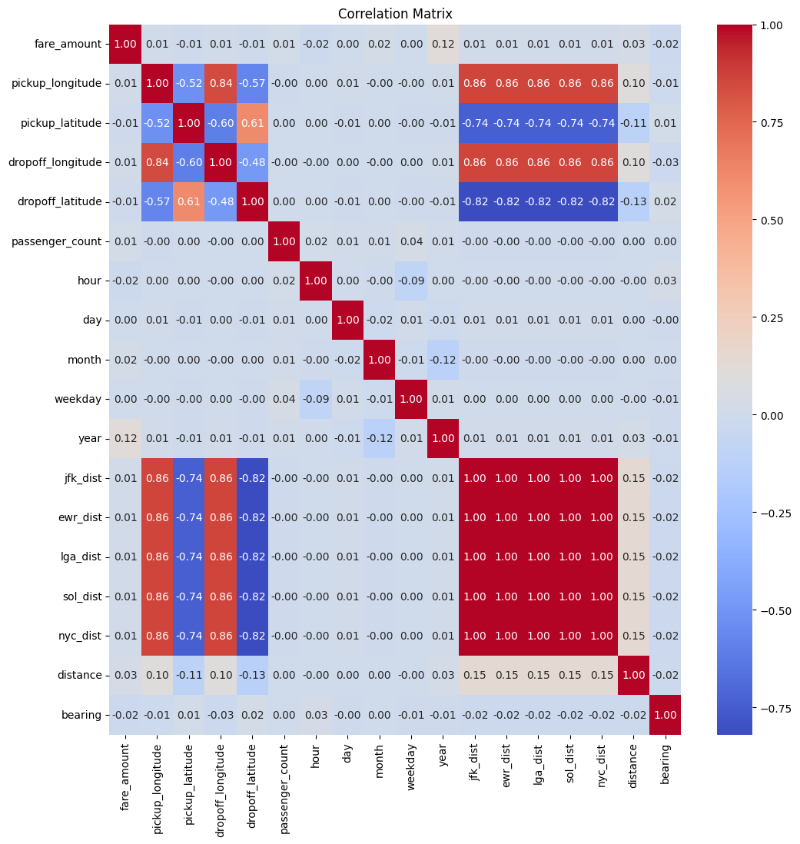
Correlation Matrix with only numerical columns

Slide 7
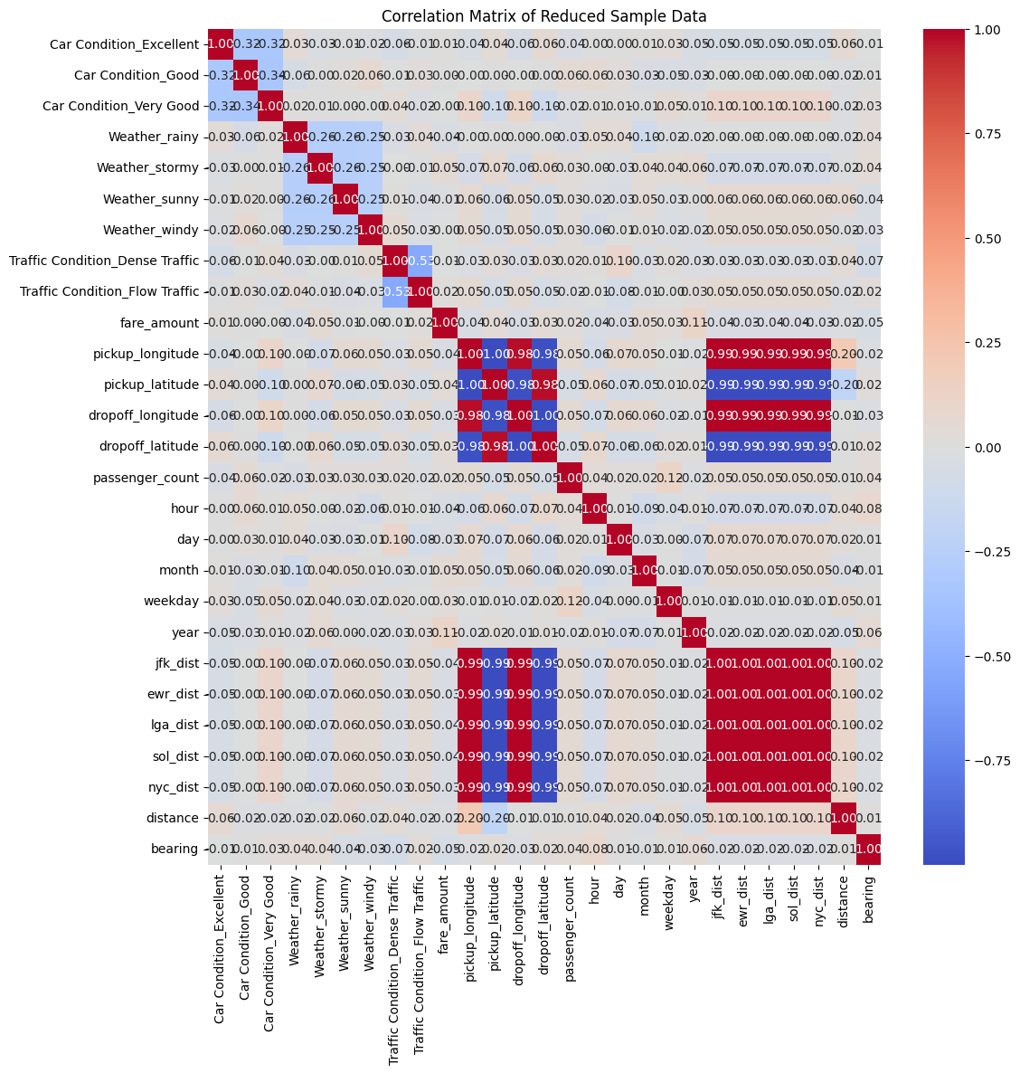
Correlation Matrix with all features (one-hot encoded categorical features)

Slide 8
Proposed Methodology
Overview of methods or models you plan to use
Multiple machine learning models such as Linear Regression, Decision Trees, and Gradient Boosting (XGBoost) to predict taxi fares.
Justification for choosing these methods, if any
Tools/Technologies (e.g., Python, libraries)
Since this is a regression problem, we are planning to use multiple regression algorithms, compare their performance and find the optimal one.
pandas
numpy
matplotlib.pyplot
seaborn
scikit-learn:
train_test_split from sklearn.model_selection
mean_absolute_error, mean_squared_error, r2_score from sklearn.metrics
LinearRegression from sklearn.linear_model
DecisionTreeRegressor from sklearn.tree
GridSearchCV from sklearn.model_selection
cross_val_score from sklearn.model_selection
xgboost
joblib
json
Streamlit

Slide 9
Expected Outcome
What do you expect to achieve?
How will you measure success?
Accurate Fare Prediction Model: A machine learning model capable of predicting the taxi fare for a given trip, based on features such as trip distance, pickup/dropoff locations, passenger count, and time-related data.
Model Evaluation Metrics: Achieving strong performance metrics like low Mean Absolute Error (MAE), Root Mean Squared Error (RMSE), and a high R-squared value (R²), indicating that the model is making precise and reliable predictions.

Slide 10
Model Comparison
Model | Parameter | Training Set | Test Set
Linear Regression | Mean Absolute Error (MAE) | 4.8943 | 4.9329
 | Mean Squared Error (MSE) | 64.1171 | 64.3020
 | R² Score | 0.3466 | 0.3512
Decision Tree | Mean Absolute Error (MAE) | 0.0096 | 2.6084
 | Mean Squared Error (MSE): | 0.0003 | 37.1167
 | R² Score | 0.9999 | 0.6255
XGBoost | Mean Absolute Error (MAE) | 1.6706 | 1.7997
 | Mean Squared Error (MSE): | 12.6767 | 19.2302
 | R² Score | 0.8708 | 0.8059
Observations:
XGBoost delivers the best performance across all metrics, explaining 80% of the variance in taxi fare predictions.
Decision Tree has moderate accuracy but falls significantly short of XGBoost's performance.
Linear Regression performs the worst, indicating challenges in capturing complex patterns in the data.

Slide 11
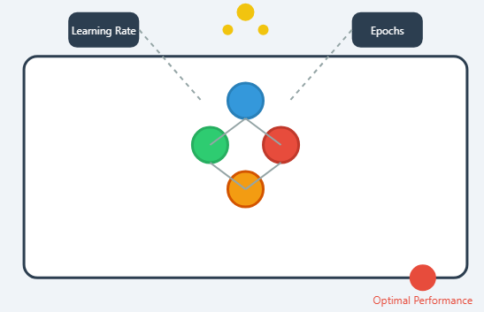
Model Finetuning
1. Outlier Treatment
Why: Outliers can significantly skew model predictions, leading to reduced accuracy and reliability.
Steps Taken:
Identified outliers using the Interquartile Range (IQR) method on residuals.
Actions:
Removed extreme outliers that heavily influenced model performance.
Retained relevant outliers to maintain dataset integrity.
Impact:
Improved the model’s ability to generalize by reducing the noise caused by extreme values.
2. Hyperparameter Tuning
Why: Optimizing hyperparameters ensures the model achieves its best possible performance for the given dataset.
Steps Taken:
Used Grid Search to systematically test combinations of key parameters such as:
Learning Rate
Maximum Depth
Number of Estimators
Evaluated performance metrics for each combination using cross-validation
Impact:
Enhanced R² score.
Reduced Mean Absolute Error (MAE) and Mean Squared Error (MSE), indicating better predictions.

Slide 12
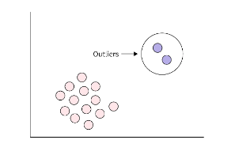
Outlier Analysis
1. Residual Calculation:
Definition: Residuals are the differences between the actual fare amounts and the predicted fare amounts generated by the XGBoost model.
Purpose: To identify data points where the model struggles to predict accurately.
2. Outlier Detection:
Method: Interquartile Range (IQR) approach.
3. Visualization:
Plot Type: Scatter plot of actual vs. predicted fares.
Highlight:
Mark outliers distinctly (e.g., red markers).
Include a diagonal line representing perfect predictions for reference.
Objective: To visually assess the distribution of residuals and the presence of outliers.
4. Outlier Summary:
Key Metrics:
Count of outliers.
Characteristics of outliers (e.g., actual fares, predicted fares, residual values).
Instances where the model significantly overpredicted or underpredicted.
Outcome:
By completing these steps, we:
Understand the nature of the outliers affecting the model.
Enhance the model's robustness by addressing outliers through appropriate measures, such as data cleaning, feature engineering, or model tuning.

Slide 13
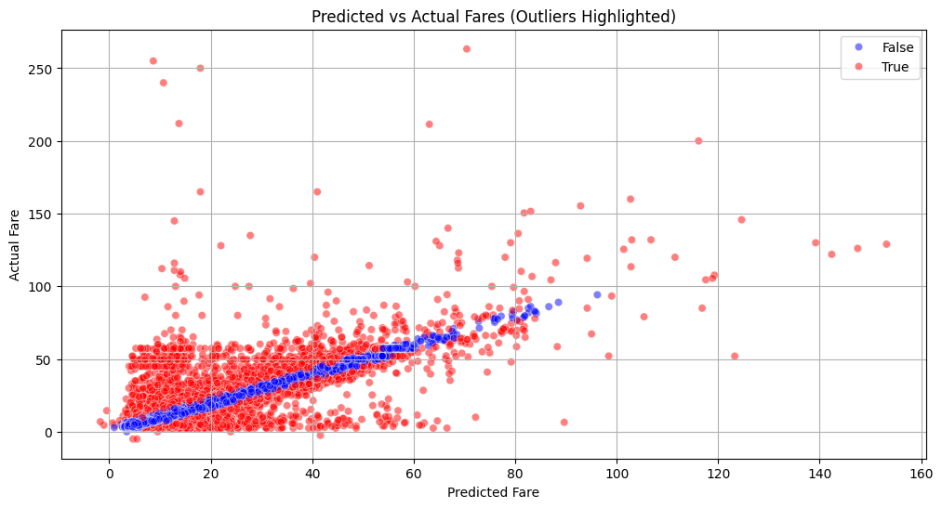
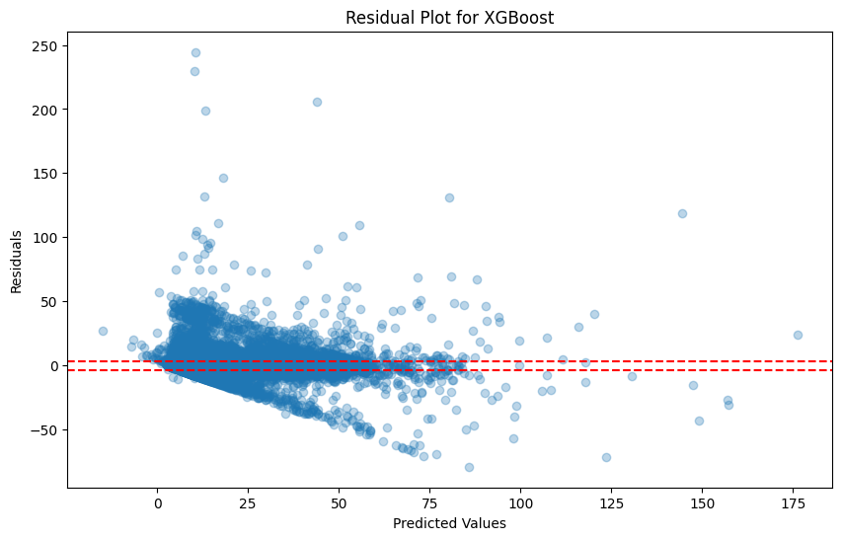
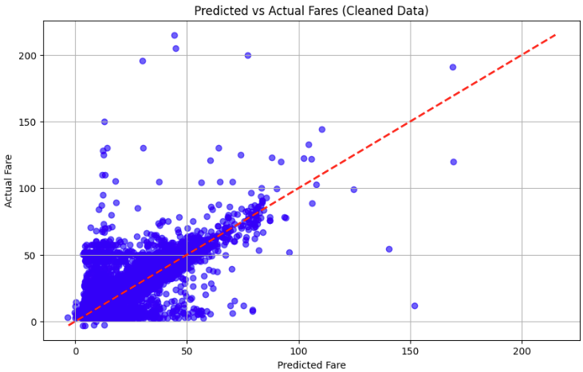
Before Outlier Treatment
Residual Plot
After Outlier Treatment

Slide 14
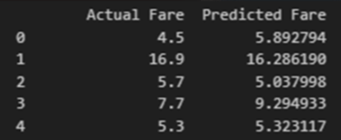
Hyperparameter Tuning
Grid Search Results for XGBoost Model
Parameter Grid
Search Method: 3-Fold Cross-Validation
Parameter Combinations: 18 candidates, 54 total fits
Grid Details:
n_estimators: [100, 200]
max_depth: [3, 5, 7]
learning_rate: [0.01, 0.1, 0.2]
Best Parameters
learning_rate: 0.1
max_depth: 7
n_estimators: 200
Performance Metrics with Best Parameters
Cross-Validation MAE: 1.6114
Average prediction error during cross-validation.
Test Set MAE: 1.5960
Final prediction error on test data.
Test Set MSE: 13.95
Penalizes larger prediction errors.
R² Score: 0.8393
Explains 83.9% of the variance in fare predictions.
Interpretation
Enhanced Performance:
Grid search improved model accuracy and generalization.
Strong Fit:
High R² score and low MAE indicate reliable predictions.
Robustness:
Model effectively captures complex relationships in the data.

Slide 15
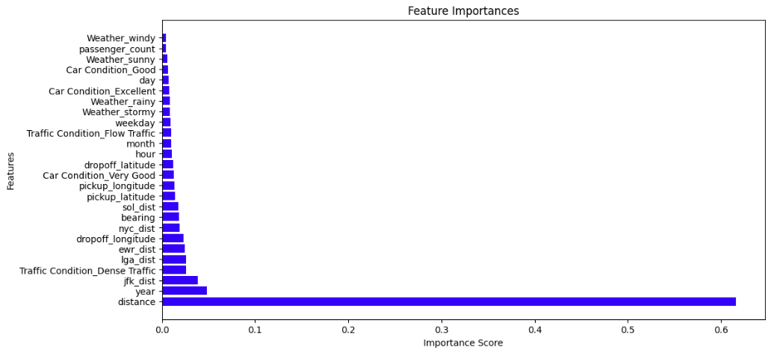
Feature Importance
Feature | Impact Level | Reason
Distance | High (Dominant) | Taxi fares are primarily calculated based on the distance traveled.
Year | High | Reflects fare policy changes or inflation effects over time.
JFK Distance | Significant | Trips to/from major airports often involve fixed rates or surcharges.
Other Landmark Distances (e.g., LGA, EWR, NYC Dist) | Moderate | Landmark proximity contributes to variability in fares.
Dropoff Longitude & Latitude | Moderate | Geographical factors influence fare calculations.
Traffic & Weather Conditions | Low | Limited data granularity or indirect influence reduces impact.
Time-Based Features (Hour, Day) | Low | Distance and location dominate fare prediction.
Passenger Count | Minimal | Passenger count has little effect on fare structure.
Car Condition | Negligible | Features like "Excellent" or "Good" ratings do not impact fare predictions.

Slide 16

Deployment
Exported the model using joblib.
Created the app using Streamlit's intuitive API.
Ensured functionality by running the app locally.
Connected streamlit with github repository.
Deployed the application via Streamlit Community Cloud.
URL to the app : Taxi Fare Prediction

Slide 17

Challenges and Risks
Challenges
Mitigation
Missing Data
Outliers
Imbalanced Data
Feature Engineering Complexity
Spatial Data Challenges (Geographical Coordinates)
Overfitting or Underfitting
Handle missing values by imputation or discarding incomplete records.
Detect and remove outliers using statistical methods like z-score or IQR.
Engineer additional features like time of day, day of week, or external data (e.g., weather).
Select appropriate evaluation metrics like MAE, RMSE and R2 errors aligned with the business objective.
Use cross-validation to avoid overfitting.

Slide 18
Thank You

